Slide 1
Game of Life Elimination
Made by: Team 3
Gregory Hooks
Kyle Haley
Jarred Deeley
Isaias Puente
Brendan Nelson-Weiss

Slide 2
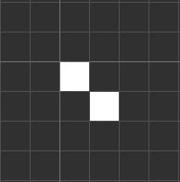
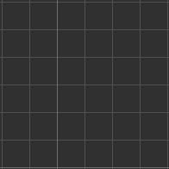
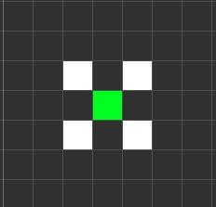
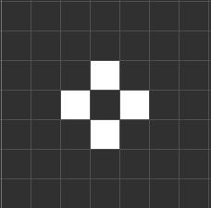
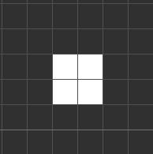
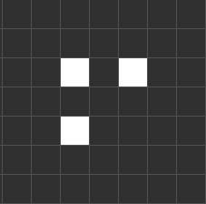
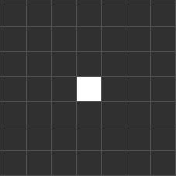
Game of Life Overview
information
Rule 1: Under-population
Rule 3: Overcrowding
Rule 2: Surviving
Rule 4: Reproduction

Slide 3
View
Anticipated classes:
Board(); Menu(); Hud();
Board -
Paints the visual elements of the board.
Menu -
Paints the visual elements of the menus.
Hud -
Paints information of the current game.

Slide 4
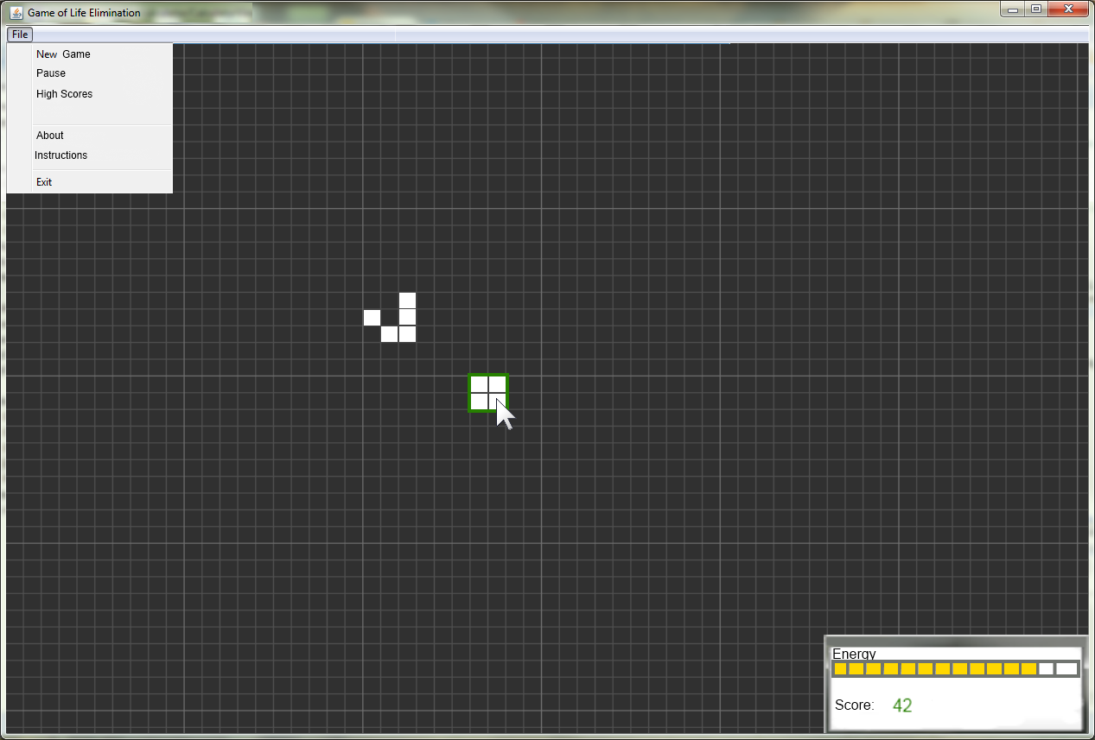
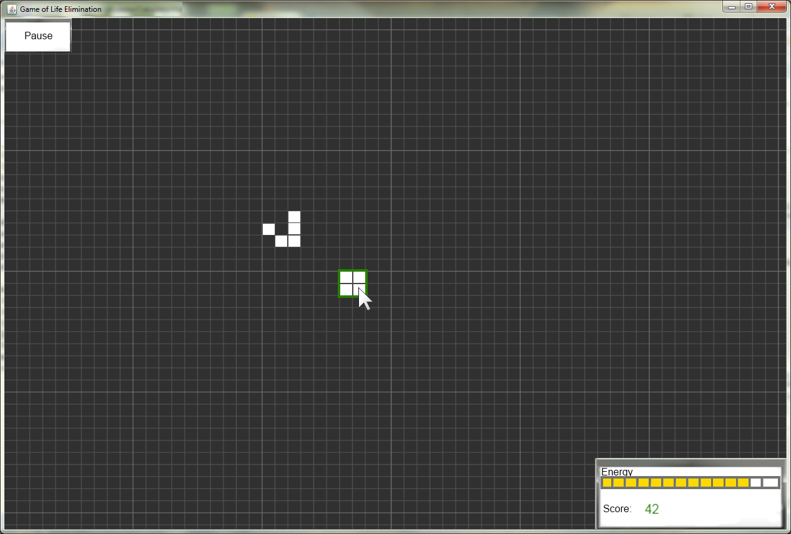
Concept Images
Made by Jarred

Slide 5
Model
Information Stored:
Configuration for initial patterns of the game.
Time and score management aspects and calculations.
Calculate progression of the game on a tick to tick basis.
Expected Classes:
Java Library: ArrayList, Array, String, primitive types.
setupShipsModel()
populateInitial()
golStateModel()
calculateTick(); removePoints(); addAllPoints();
injectUserClick(); getPoint(); clearBoard();

Slide 6
Controller
Anticipated Classes & Methods:
~ golMenuController{}; golRepaintController{};
actionPerformed();
~ golMouseController{};
mouseClicked(); mousePressed(); mouseReleased(); mouseEntered(); mouseExited(); mouseDragged();
~ golResizeController{};
componentResized();
Use of methods:
Menus
Tracking mouse activity
Design of the board

Slide 7
Our Planned Milestones
Easy Milestone:
Recreate the game of life in the model, view, controller design.
Hard Milestone:
Automate creation of life (including pre-defined patterns) and relegate
user interaction to elimination.
Final Milestone:
Add time limitations and scoring system.

